Slide 1
Design Patterns
Chapter 11

Slide 2
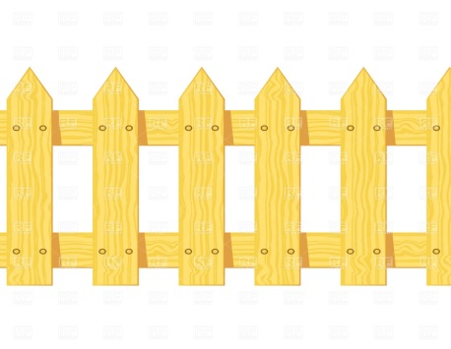
Software Barriers
Sometimes the data/object you need is just beyond your reach
Process/Platform Barrier
Permission Barrier
Database/Persistence Barrier
Efficiency Barrier
Memory Representation Barrier

Slide 3

The Nature of Barriers
Obstacles we must get around/climb over
It takes special attention, distracting us from the task at hand.
Software: it usually translates to an if-statement
… every place the barrier might be encountered

Slide 4


Slide 5
Barriers in software
How do you get by a barrier in software?
Well, it certainly involves one or more if-statements!
Example: if (swbarrier1() == true) do_stuff();

Slide 6

Understanding Code
Studies have indicated that at least 50% of the software maintenance effort goes to understanding the existing code.
Learning code is very much flow-based: you get in the flow of following the program.
Extraneous if-statements break your mental flow
Surmounting barriers has lasting effects!

Slide 7
Polymorphism, once again
What is the big benefit of polymorphism?
We treat all subclasses the same
But the bits don’t care! Who is it for?
So we don’t have if-statements littering our code
It’s a flow thing again
But not all if-statements can be solved with polymorphism
There are other barriers besides subtypes …

Slide 8
Caveat
Don’t let barriers obscure you from solving the real problem
Violates SRP, encapsulating variation
You mix problem-solving code with connectivity details (for example)
These two may change independently
Hide the details of crossing barriers
From the user
From yourself

Slide 9

Process/Platform Barrier
The object you want resides in another process
That process could even be on another machine on the network
You want to be able to behave as if the object is in your own process space
The communication details will be hidden in other, behind-the-scenes objects

Slide 10

Permission Barrier
Access to objects is protected
Details of what access levels exist and how to fulfill them is hidden

Slide 11

Persistence Barrier
An object’s data is in a database
Usually a relational DBMS
You want retrieval and update to be automatic
Details of which are hidden in unseen objects
"13-11-02-olb-by-RalfR-03" by Ralf Roletschek - Own work. Licensed under CC BY 3.0 via Commons - https://commons.wikimedia.org/wiki/File:13-11-02-olb-by-RalfR-03.jpg#/media/File:13-11-02-olb-by-RalfR-03.jpg

Slide 12

Efficiency Barrier
You have a large object that is expensive to load or initialize
You want to wait until it’s needed to do the work (“Lazy Initialization”)
Or you want a thread to load it while you do other things

Slide 13

Memory Representation Barrier
The objects you use have special memory requirements
They use reference counting to share themselves among multiple objects
Or they are stored in an unusual fashion
Bitsets packed into integer arrays
They are computed on the fly

Slide 14
A Solution
Before we go on, see what you can come up with. Suggestions?

Slide 15
The Proxy Pattern aka Surrogate
Intent:
Provide a go-between object that controls access to another object of interest
Context:
Access to an object lies behind some kind of (conceptual or physical) barrier. You need to control access to the object of interest.
Solution:
Introduce another level of indirection between clients and objects. The new layer controls access to objects, hiding details of penetrating barriers from clients and their server objects.

Slide 16
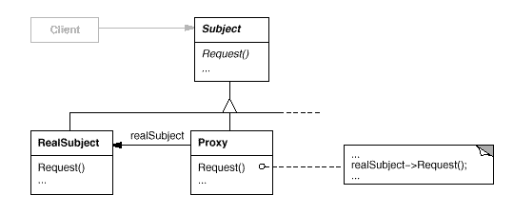
The Proxy Pattern Class Sketch
Note the uses relationship. It doesn’t necessarily contain the RealSubject (but may)

Slide 17
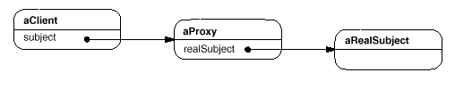
The Proxy Pattern Object Sketch

Slide 18
The Proxy Pattern Key Features
The proxy object implements the same interface as the original object
It may wrap the original object
It provides the code to resolve the barriers to access
It may forward to the original object as needed
It may create the original object if needed

Slide 19
Example: Remote Proxy
To use an object in another process space requires inter-process communication
Could be over a network
The “proxy” consists of two classes:
A “stub” in the client process
A “skeleton” in the server process
Communication:
Requests are sent from the client through the stub to the skeleton
Data is “marshaled” back through the skeleton to the stub to the client
See pages 437-440

Slide 20
Example: Reference Proxy
The index operator ([ ]) in C++’s std::bitset
Bits are packed into words
And are not addressable
Accessing a bit for update is different than for retrieval
b[i] = true; // update
bool x = b[i]; // retrieval

Slide 21
Example: Reference Proxy ~continued~
Note: the interface is implicit
It’s just the [ ] operator
Must somehow distinguish between left- and right-hand side usage
LHS => assignment to a bitset
RHS => converting a bit to a bool

Slide 22
Example: Reference Proxy ~continued~
Solution:
Introduce a new class as a placeholder for indexing
Overload operators to detect usage:
The assignment operator will set a bit
The bool conversion function will test a bit

Slide 23
Example: Persistence Proxy
Where should DB knowledge reside?
Not in Client code!
Certainly not in each object you want to persist (DRY)
Remember the DIP
Abstractions should not depend on details
Keep business rules separate from DB details
Alternatives:
Inherit from a class that has most of the knowledge and provide the missing pieces
(Template Method Mixin)
Use a Proxy (next slide)

Slide 24
Persistence Proxy

Slide 25
Example: Persistence Proxy
Implementation Choices:
1) Load at construction of Proxy
2) Load/update on every access
Both have plusses, minuses
Example: DBProxy.cpp

Slide 26
Example: Virtual Proxy
Virtual Proxy acts like the real object
Creates the object when necessary
Delegates calls to the real object at the right time
Pages 462 – 470
See also 471

Slide 27
De ja vous all over again?
Remind you of any other patterns?
It looks like a fancy decorator!
What are the differences?
Yet another fireside chat
P. 472-473, 487

Slide 28
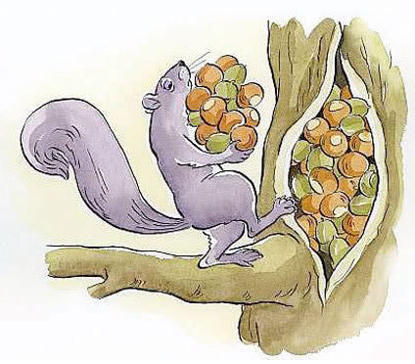
Example: Caching Proxy
Your guess: what’s a caching proxy?
And how does it work?

Slide 29
Stairway To Heaven An Class Adapter Extension to a Persistence Proxy
MI Required

Slide 30
Other DB-Related Patterns
Decorator
Can decorate an object with DB ops or vice-versa
Façade
Works nice for smaller apps
A monolith class does everything and then you provide a simpler interface for product-only use

Slide 31
Reference Counting
A combination of:
Virtual Proxy
Because some actions are delayed
Reference Proxy
The proxy controls memory usage
Example: Copy-on-write strings (cow.cpp)

Slide 32
Smart Pointers
A Reference Proxy
Can be used for many purposes
Caching, RAII (resource management) reference counting, permission, even remoting (ATL COM smart pointers)
Examples:
auto_ptr
shared_ptr, weak_ptr

Slide 33
About operator-> in C++
It’s purpose is to yield a member of a structure or class
When you overload it, you intercept it before it yields the member
Therefore, you do your behind-the-scenes work and finally return a lower-level pointer, p
Then p->x is executed (so -> happens at least twice)

Slide 34
std::auto_ptr
Holds a low-level heap pointer
Overloads * and ->
When its destructor executes, it deletes its pointer
Sample implementation in auto_ptr.h

Slide 35
shared_ptr
From Boost
Part of C++ 11
Difference from auto_ptr:
Uses reference counting, not strict ownership
You can have a vector of shared_ptrs
Can also have an optional deleter function object
For releasing resources other than memory
See shared.cpp
weak_ptr is an observer
It doesn’t participate in the count
Its internal ptr is set to null when observable’s count goes to 0

Slide 36
Review: Let’s go to the Zoo!
P. 487 - 488

Slide 37
Summary
Proxy is for when using an object directly won’t do
You want to protect it (security)
It’s on another machine
Or otherwise not directly addressable (like bitset)
You need special handling
Like reference counting

